Slide 1
XPath in selenium
Sarower Ahmmed

Slide 2
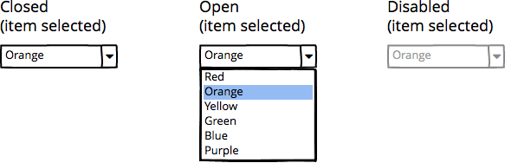
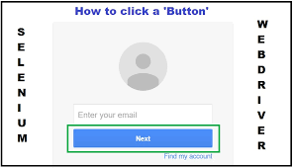
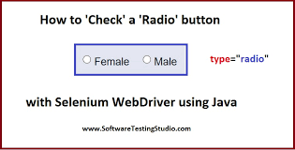
What is WebElement?
It’s a part or component of a web page
Text box, Button, Drop Down, Hyperlink
Check Box, Radio Button

Slide 3
What is WebElement?
WebElement represents an HTML element.
HTML documents are made up by HTML elements. HTML elements are written with a start tag, with an end tag, with thecontent in between:
<tagname> content </tagname>
<div> id=‘email’ </div>
<input> id=‘email’ </input>
.

Slide 4
Locators for Selenium
Locators in selenium are ways to locate the web elements on webpage.
WebDriver is using element locators to find out and perform actions on webpage

Slide 5

Locator in selenium

Slide 6
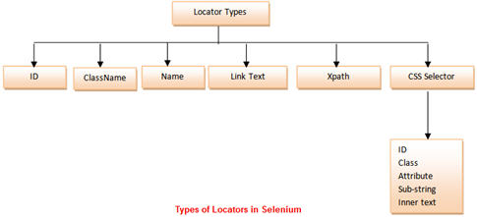
Locator in selenium

Slide 7
Locator in selenium
Id: Select element with the specified @id attribute.
Name: Select element with the specified @name attribute.
Linktext: Select link (anchor tag) element which contains text matching the specified link text
Partial Linktext: Select link (anchor tag) element which contains text matching the specified partial link text
Tag Name: Locate Element using a Tag Name .
Class name: Locate Element using a Tag Name ..
Css: Select the element using css selectors.
Xpath: Locate an element using an XPath expression.

Slide 8
Locating an Element By id:
Example :
<input id="email" class="required" type="text"/>
We can write the scripts as:
WebElement Ele = driver.findElement(By.id(" email "));

Slide 9
Locating an Element By Name:
Example:
<input name="register" class="required" type="text"/>
WebElement register= driver.findElement(By.name("register"));

Slide 10
Locating an Element By LinkText:
Example:
<a href="http://www.seleniumhq.org">Downloads</a>
WebElement download = driver.findElement(By.linkText("Downloads"));

Slide 11
Locating an Element By Partial LinkText:
Example:
<a href="seleniumhq.org">Download selenium server</a>
WebElement download = driver.findElement(By.PartialLinkText("Download"));

Slide 12
Locating an Element By TagName:
Select select = new Select(driver.findElement(By.tagName("select")));
select.selectByVisibleText("Nov");
or
select.selectByValue("value");

Slide 13
Locating an Element By Class Name:
<input name="register" class=" sample " type="text"/>
WebElement classtest =driver.findElement(By.className(“sample”));

Slide 14
CSS Selector:
CSS mainly used to provide style rules for the web pages and we can use for identifying one or more elements in the web page using css. If you start using css selectors to identify elements, you will love the speed when compared with XPath. We can you use Css Selectors to make sure scripts run with the same speed in IE browser. CSS selector is always the best possible way to locate complex elements in the page.
Example:
WebElement CheckElements = driver.findElements(By.cssSelector("input[id=email']"));

Slide 15
XPath Selector:
XPath is designed to allow the navigation of XML documents, with the purpose of selecting individual elements, attributes, or some other part of an XML document for specific processing

Slide 16
Definition
Xpath is one of the locator of my DOM.html page.
OR
Xpath is a used to locate and navigate element in xml page.

Slide 17
Interview question
Which locator do you use the most?
Xpath
Why do you use xpath.
To handle dynamic object
Why do you use CssSelector?
To locate image, color, text, image (video).
How to handle java script in selenium
Use javascript Executor

Slide 18
What is dynamic object?
If any object locator value change partially and frequently
Example :
<input id="email" class="required" type="text"/>
Next
<input id="email2" class="required" type="text"/>
Next
<input id="email3" class="required" type="text"/>

Slide 19
There are two types of xpath
1.Absolute (Native) Xpath, it is like directing the xpath to go in direct way. like
Example: html/head/body/table/tr/td
Here the advantage of specifying native path is, finding an element is very easy as we are mention the direct path. But if there is any change in the path (if some thing has been added/removed) then that xpath will break.
2. Relative Xpath In relative xpath we will provide the relative path, it is like we will tell the xpath to find an element by telling the path in between. Advantage here is, if at all there is any change in the html that works fine, until unless that particular path has changed. Finding address will be quite difficult as it need to check each and every node to find that path.

Slide 20
Xpath basic formula
.//tagname[@attribute-name='value'] =relative xpath
ex=>//input[@id='name']
./grandparent(div-id)xpath//parentxpath//childxpath=absolute xpath

Slide 21
Why Single /double slash in xpath?
double slash::
.//tagname[@attribute-name='value'] =relative xpath
It’s relative xpath.
Note it selects my specific element and go from there.
8. Why single slash in xpath?
./grandparent(div-id)xpath//parentxpath//childxpath=absolute xpath
It is absolute xpath.
Note it select from root to desired element.(it maintain higher keys such as grandparent-parent & child relation

Slide 22
which one is grandparent HTML tag?
If any tag = div
9. Why do we use Star in xpath?
Star means, "Select all".
ex //*
10. While one do you use in workplace?
Relative
11. Why Relative?
It’s finds specific element since it find out specific match of each element and not deepens on relation of parents object

Slide 23
Which tool do you use to find the element on the html page?
Dev tool (firebug, fire path) – Firefox
Dev tool /F12 and use inspect- IE and chrome

Slide 24
.What do you do when you face more than one matching of web element?
Group the xpath 1st than use number of element
How do create custom xpath?
://tagname[@attribute-name='value']
ex=>"//input[@id='name']" or more attribute values
ex=>//input[@name='track']

Slide 25
What are the xpath methods to handle dynamic object or element?
Contains
Starts-with
Following node
Presiding node

Slide 26
Contain method
: //tagname[contains(@id,'value')]
//id=abc"123"
//id=abc"124"
//id=abc"125"
//id=abc"126"
contain method has one part fixed >>> here "abc" was fixed

Slide 27
.starts with. //it starts with abc //It's same as contain method
: //tagname[starts-with(@id,'value')]
3.following node. //we use this method to handle textbox dynamic element.
//follow to the next.
//*[contains(text(),'')]//following::input
4.preceding node.
//follow to the previous
Xpath=//*[@type='submit']//preceding::input

Slide 28
Create xpath from xml code
Use :absolute xpath
Xpath :: /bookstore/book1/[price=30.00]
<bookstore>
<book>
<price> 30.00 </price>
</book>
</bookstore>

Slide 29
#### create xpath with anchor link a and href
#### create xpath with
<a href="url" onClick = "doSomething()">link text</a>
Answer: "//a[@href='url']"

Slide 30
How to locate text with xpath
<p type=“body">login</p> Answer:
Need to locate login
//p[@type= body ']/text()
Or
//*[contains(text(),’ login’)]

Slide 31
Problem solve
<p class="main-content">
This is sample paragraph with <a href="http://google.com">link</a> inside.
</p>
need to get following text : "This is sample paragraph with link inside",
Xpath:: //p[@class= ‘main-content']/text()
gives me only "This is sample paragraph with inside"

Slide 32
a valid XHTML file:
<p>hello <span>world</span> a </p>
<p>Hi there </p>
<p>The End </p>
Print:
'hello '
' a '
'Hi there '
'The End '
Answer: //p/child::text()[last()] or //root/p/child::text()[last()]

Slide 33
<root>
<elemA>one</elemA>
<elemA attribute1='first' attribute2='second'>two</elemA>
<elemB>three</elemB>
<elemA>four</elemA>
<elemC>
<elemB>five</elemB>
</elemC>
</root>
to produce the following xpath:
//root[1]/elemA[1]='one'
//root[1]/elemA[2]='two'
//root[1]/elemA[2][@attribute1='first']=first
//root[1]/elemA[2][@attribute2='second']=secong
//root[1]/elemB[1]='three'
//root[1]/elemA[3]='four'
//root[1]/elemC[1]/elemB[1]='five'

Slide 34
<root>
<p>hello <span>world</span> a </p<p>Hi there </p>
<p>The End </p>
</root>
> Answer: "//root[1]/p[1]=hello" or
//*[contains(text(),'hello')]

Slide 35
Xpath from web table
Web table is a table in webpage in your application
Look for table = whole table
Look for tbody =table body only
Look for tr= table rows
Look for td= table cells/column

Slide 36
More example
Example: //table/tr/td
Example Syntax to work with Image
xpath=//img[@alt='image alt text goes here']
Example syntax to work with table
xpath=//table[@id='table1']//tr[4]/td[2]
xpath=(//table[@class='nice'])//th[text()='headertext']/
Example syntax to work with anchor tag
xpath=//a[contains(@href,'href goes here')]
xpath=//a[contains(@href,'#id1')]/@class
Example syntax to work with input tags
xpath=//input[@name='name2' and @value='yes']

